Slide 1


04/07/2023
Formation à l’électronique numérique FPGA
Segment 4 : Etude d’un système complexe SoC
Référence filière : F-230417-DIS-399-FPGA_SAFRAN
1

Slide 2
04/07/2023
Objectifs :
Connaitre les autres métiers qui interviennent autour du FPGA
Connaitre les standards de transmissions internes d’un SoC
Explorer des exemples réalisées en contexte industriel
Faire l’étude de faisabilité de son projet final
Nombre de journées : 3
Evaluation : Appréciation comportementale, Plan de validation
Référence filière : F-230417-DIS-399-FPGA_SAFRAN
2

Slide 3
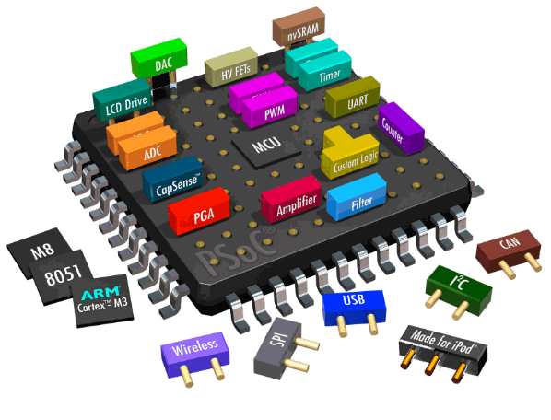
SoC
System On Chip
Un SoC est une puce qui va contenir des blocs de calculs de nature différentes chacune adaptée au traitement d’un type de donnée (vidéo, audio, réseau ect…) ou à la transmission d’un type de donné
On peut le considérer comme un système hybride qui peut alors contenir à la fois des CPUs, des GPUs ou des FPGAs pour ne citer que quelques exemples.
Notes:
Entre nous humain, nous utilisons ce qu’on appel la base décimale pour communiquer les quantités. Dans d’autres cultures, on utilise des bases différentes (par exemple en Rome antique c’était la base 16 hexadécimale qui était utilisées pendant un temps), généralement la base 10 est privilégiée, sans doute parce que nous avons dix doigts,
Pédagogie active : les TDs permettent aux étudiants de construire leur cours
Les chiffres dans le monde numérique sont représentés sous la forme de séquences de 0 et 1. Cela étant car toutes puces, mis à part les technologies les plus avancées comme les puces quantiques et photoniques, utilisent des transistors (micro-interrupteurs) qui ne disposent que de deux états physique; ouvert ou fermé.

Slide 4
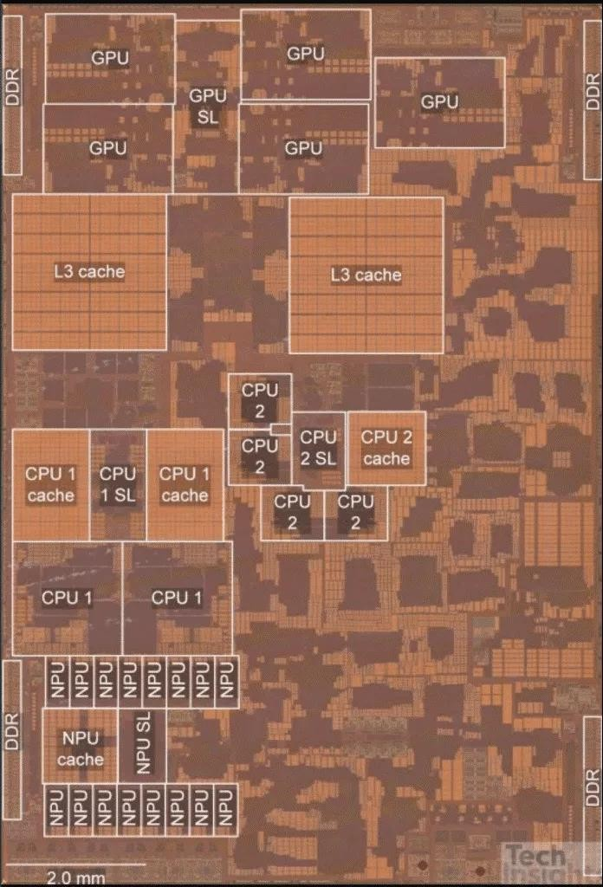
SoC
Exemple d’une puce SoC contenant à la fois un CPU un NPU et un GPU
CPU : Central Processing Unit
GPU : Graphical Processing Unit
NPU : Neural Processing Unit
GPU
NPU
CPU
Notes:
When two numbers are added on a CPU (Central Processing Unit), the CPU performs a series of steps to carry out the addition. Here's a simplified explanation of how this works:
Fetching: The CPU fetches the two numbers (in binary format) from memory or registers and loads them into its internal processing unit.
Decoding: The CPU decodes the instructions that tell it to add the two numbers together.
Addition: The CPU adds the two numbers using a series of logic gates that perform binary addition, similar to the method I explained earlier using Boolean logic. These logic gates take the two input bits and produce a sum bit and a carry bit.
Carry propagation: If there is a carry bit produced in step 3, the CPU must propagate the carry bit to the next bit position. This is done by connecting the carry output of one adder to the carry input of the next adder in a chain.
Result storage: Once the addition is complete, the CPU stores the result (in binary format) back into memory or registers.
The above process is a high-level overview of how addition is carried out on a CPU. In reality, modern CPUs are much more complex and perform many more operations in parallel. They use highly optimized circuits and algorithms to carry out arithmetic operations quickly and efficiently.

Slide 5
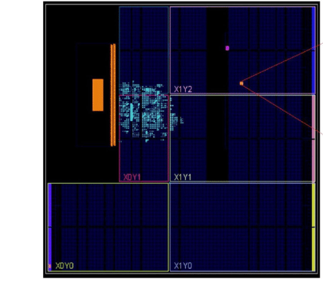
SoC
Exemple du SoC zynq7010 de la coraZ7
CPU Arm Cortex
FPGA
Notes:
When two numbers are added on a CPU (Central Processing Unit), the CPU performs a series of steps to carry out the addition. Here's a simplified explanation of how this works:
Fetching: The CPU fetches the two numbers (in binary format) from memory or registers and loads them into its internal processing unit.
Decoding: The CPU decodes the instructions that tell it to add the two numbers together.
Addition: The CPU adds the two numbers using a series of logic gates that perform binary addition, similar to the method I explained earlier using Boolean logic. These logic gates take the two input bits and produce a sum bit and a carry bit.
Carry propagation: If there is a carry bit produced in step 3, the CPU must propagate the carry bit to the next bit position. This is done by connecting the carry output of one adder to the carry input of the next adder in a chain.
Result storage: Once the addition is complete, the CPU stores the result (in binary format) back into memory or registers.
The above process is a high-level overview of how addition is carried out on a CPU. In reality, modern CPUs are much more complex and perform many more operations in parallel. They use highly optimized circuits and algorithms to carry out arithmetic operations quickly and efficiently.

Slide 6
SoC
Quel intérêt d’avoir à la fois un CPU/MCU et un FPGA ?
Dans un contexte de traitement vidéo, le SoC FPGA permet de repartir efficacement les algorithmes de traitement entre les deux unités de traitement.
Par exemple, les algorithmes de « pre-processing » sont extrêmement efficaces et simples à mettre en œuvre sur un FPGA (filtre de gauss)
A contrario, les algorithmes d’analyse plus poussés (comme une IA) sont beaucoup plus simples à mettre en place sur un CPU. (notamment grâce aux multiples librairies disponibles)
Notes:
When two numbers are added on a CPU (Central Processing Unit), the CPU performs a series of steps to carry out the addition. Here's a simplified explanation of how this works:
Fetching: The CPU fetches the two numbers (in binary format) from memory or registers and loads them into its internal processing unit.
Decoding: The CPU decodes the instructions that tell it to add the two numbers together.
Addition: The CPU adds the two numbers using a series of logic gates that perform binary addition, similar to the method I explained earlier using Boolean logic. These logic gates take the two input bits and produce a sum bit and a carry bit.
Carry propagation: If there is a carry bit produced in step 3, the CPU must propagate the carry bit to the next bit position. This is done by connecting the carry output of one adder to the carry input of the next adder in a chain.
Result storage: Once the addition is complete, the CPU stores the result (in binary format) back into memory or registers.
The above process is a high-level overview of how addition is carried out on a CPU. In reality, modern CPUs are much more complex and perform many more operations in parallel. They use highly optimized circuits and algorithms to carry out arithmetic operations quickly and efficiently.

Slide 7


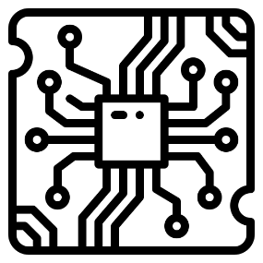
SoC
Quels métiers sont impliqués ?
Cela dépend évidement du design à réaliser mais généralement on en retrouve trois principaux
Hardware
Gateware
Software
Notes:
When two numbers are added on a CPU (Central Processing Unit), the CPU performs a series of steps to carry out the addition. Here's a simplified explanation of how this works:
Fetching: The CPU fetches the two numbers (in binary format) from memory or registers and loads them into its internal processing unit.
Decoding: The CPU decodes the instructions that tell it to add the two numbers together.
Addition: The CPU adds the two numbers using a series of logic gates that perform binary addition, similar to the method I explained earlier using Boolean logic. These logic gates take the two input bits and produce a sum bit and a carry bit.
Carry propagation: If there is a carry bit produced in step 3, the CPU must propagate the carry bit to the next bit position. This is done by connecting the carry output of one adder to the carry input of the next adder in a chain.
Result storage: Once the addition is complete, the CPU stores the result (in binary format) back into memory or registers.
The above process is a high-level overview of how addition is carried out on a CPU. In reality, modern CPUs are much more complex and perform many more operations in parallel. They use highly optimized circuits and algorithms to carry out arithmetic operations quickly and efficiently.

Slide 8
SoC
Quels métiers sont impliqués ?
Chacun de ces métiers doivent communiquer entre eux afin d’assurer la réussite d’un projet, souvent le gateware fait interface et est très sollicité car il fait le lien entre la couche hardware et software
Hardware
Gateware
Software
Notes:
When two numbers are added on a CPU (Central Processing Unit), the CPU performs a series of steps to carry out the addition. Here's a simplified explanation of how this works:
Fetching: The CPU fetches the two numbers (in binary format) from memory or registers and loads them into its internal processing unit.
Decoding: The CPU decodes the instructions that tell it to add the two numbers together.
Addition: The CPU adds the two numbers using a series of logic gates that perform binary addition, similar to the method I explained earlier using Boolean logic. These logic gates take the two input bits and produce a sum bit and a carry bit.
Carry propagation: If there is a carry bit produced in step 3, the CPU must propagate the carry bit to the next bit position. This is done by connecting the carry output of one adder to the carry input of the next adder in a chain.
Result storage: Once the addition is complete, the CPU stores the result (in binary format) back into memory or registers.
The above process is a high-level overview of how addition is carried out on a CPU. In reality, modern CPUs are much more complex and perform many more operations in parallel. They use highly optimized circuits and algorithms to carry out arithmetic operations quickly and efficiently.

Slide 9
SoC
Partage d’expérience : Interaction Hardware / Gateware cas typique
On souhaite construire une interface avec un composant nouveau, par exemple un nouveau type de mémoire mis sur le marché ou bien un composant très spécifique comme un composant endurci pour des applications spatiales.
Il n’existe pas de carte de développement disponibles sur étagère pour tester le composant en question. Il va donc falloir mettre au point un système de carte pour réaliser la validation.
Notes:
When two numbers are added on a CPU (Central Processing Unit), the CPU performs a series of steps to carry out the addition. Here's a simplified explanation of how this works:
Fetching: The CPU fetches the two numbers (in binary format) from memory or registers and loads them into its internal processing unit.
Decoding: The CPU decodes the instructions that tell it to add the two numbers together.
Addition: The CPU adds the two numbers using a series of logic gates that perform binary addition, similar to the method I explained earlier using Boolean logic. These logic gates take the two input bits and produce a sum bit and a carry bit.
Carry propagation: If there is a carry bit produced in step 3, the CPU must propagate the carry bit to the next bit position. This is done by connecting the carry output of one adder to the carry input of the next adder in a chain.
Result storage: Once the addition is complete, the CPU stores the result (in binary format) back into memory or registers.
The above process is a high-level overview of how addition is carried out on a CPU. In reality, modern CPUs are much more complex and perform many more operations in parallel. They use highly optimized circuits and algorithms to carry out arithmetic operations quickly and efficiently.

Slide 10
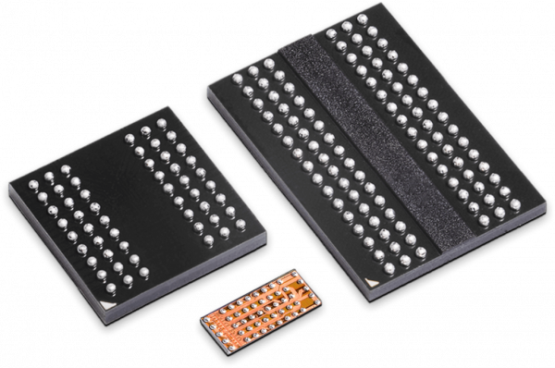
SoC
Partage d’expérience : Interaction Hardware / Gateware cas typique
Cas d’étude de l’intégration de la RPC DRAM, une mémoire ultracompacte commercialisée depuis 2021.
Afin de valider l’intégration de ce nouveau composant un jeu de cartes doit être réalisé, une interface gateware doit être conçue en plus de cela
Notes:
When two numbers are added on a CPU (Central Processing Unit), the CPU performs a series of steps to carry out the addition. Here's a simplified explanation of how this works:
Fetching: The CPU fetches the two numbers (in binary format) from memory or registers and loads them into its internal processing unit.
Decoding: The CPU decodes the instructions that tell it to add the two numbers together.
Addition: The CPU adds the two numbers using a series of logic gates that perform binary addition, similar to the method I explained earlier using Boolean logic. These logic gates take the two input bits and produce a sum bit and a carry bit.
Carry propagation: If there is a carry bit produced in step 3, the CPU must propagate the carry bit to the next bit position. This is done by connecting the carry output of one adder to the carry input of the next adder in a chain.
Result storage: Once the addition is complete, the CPU stores the result (in binary format) back into memory or registers.
The above process is a high-level overview of how addition is carried out on a CPU. In reality, modern CPUs are much more complex and perform many more operations in parallel. They use highly optimized circuits and algorithms to carry out arithmetic operations quickly and efficiently.

Slide 11
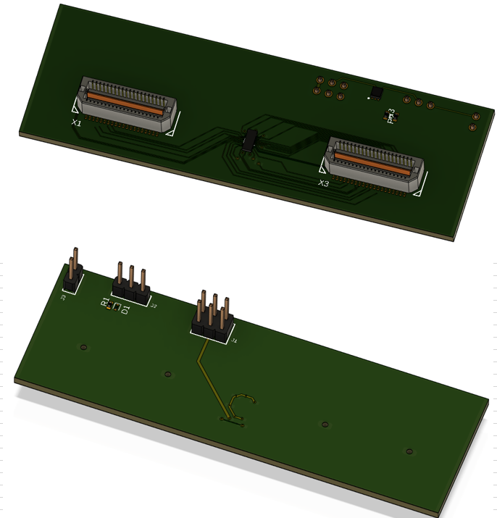
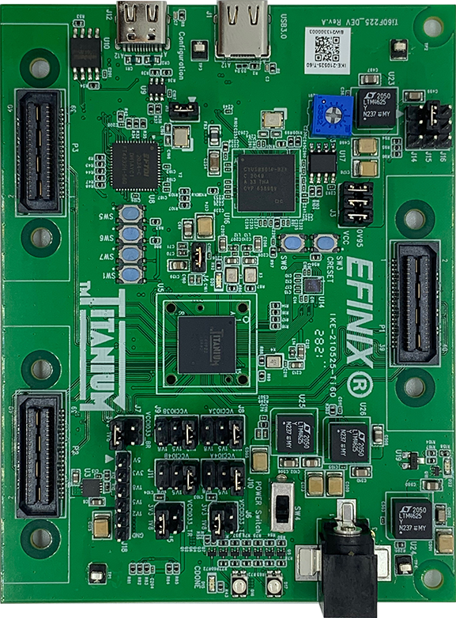
SoC
Partage d’expérience : Interaction Hardware / Gateware cas typique
Notes:
When two numbers are added on a CPU (Central Processing Unit), the CPU performs a series of steps to carry out the addition. Here's a simplified explanation of how this works:
Fetching: The CPU fetches the two numbers (in binary format) from memory or registers and loads them into its internal processing unit.
Decoding: The CPU decodes the instructions that tell it to add the two numbers together.
Addition: The CPU adds the two numbers using a series of logic gates that perform binary addition, similar to the method I explained earlier using Boolean logic. These logic gates take the two input bits and produce a sum bit and a carry bit.
Carry propagation: If there is a carry bit produced in step 3, the CPU must propagate the carry bit to the next bit position. This is done by connecting the carry output of one adder to the carry input of the next adder in a chain.
Result storage: Once the addition is complete, the CPU stores the result (in binary format) back into memory or registers.
The above process is a high-level overview of how addition is carried out on a CPU. In reality, modern CPUs are much more complex and perform many more operations in parallel. They use highly optimized circuits and algorithms to carry out arithmetic operations quickly and efficiently.

Slide 12
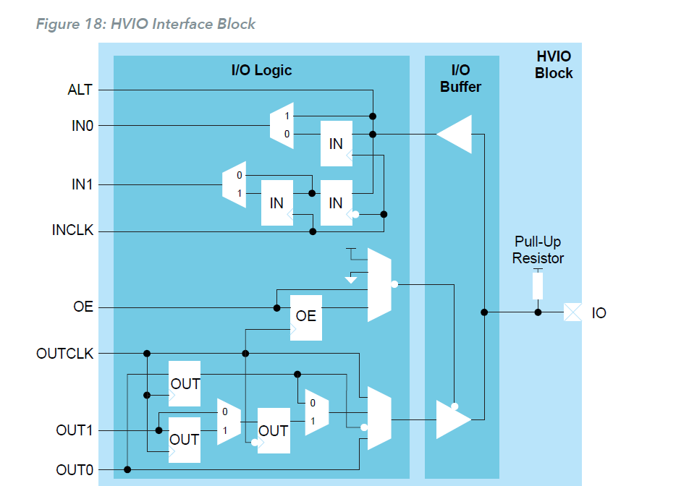
SoC
Partage d’expérience : Interaction Hardware / Gateware cas typique
Pour mener à bien ce type de travaux, il est primordial d’avoir une connaissance fine des interfaces avec lesquelles nous travaillons côté FPGA (standard de transmission, bande passante des IO ect..)
Notes:
When two numbers are added on a CPU (Central Processing Unit), the CPU performs a series of steps to carry out the addition. Here's a simplified explanation of how this works:
Fetching: The CPU fetches the two numbers (in binary format) from memory or registers and loads them into its internal processing unit.
Decoding: The CPU decodes the instructions that tell it to add the two numbers together.
Addition: The CPU adds the two numbers using a series of logic gates that perform binary addition, similar to the method I explained earlier using Boolean logic. These logic gates take the two input bits and produce a sum bit and a carry bit.
Carry propagation: If there is a carry bit produced in step 3, the CPU must propagate the carry bit to the next bit position. This is done by connecting the carry output of one adder to the carry input of the next adder in a chain.
Result storage: Once the addition is complete, the CPU stores the result (in binary format) back into memory or registers.
The above process is a high-level overview of how addition is carried out on a CPU. In reality, modern CPUs are much more complex and perform many more operations in parallel. They use highly optimized circuits and algorithms to carry out arithmetic operations quickly and efficiently.

Slide 13
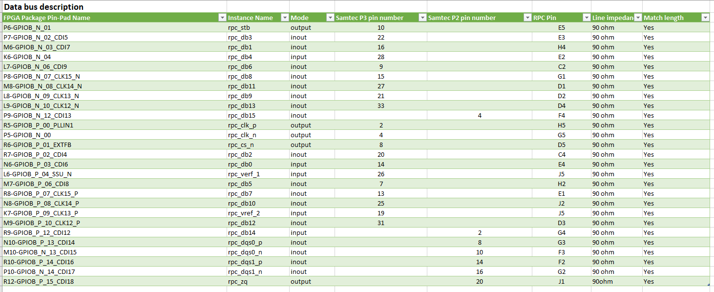
SoC
Partage d’expérience : Interaction Hardware / Gateware cas typique
A la suite de cette étude, il faut communiquer aux ingénieurs hardware les détails leur permettant d’effectuer un placement adéquat des I/O, il est souvent nécessaire de switcher certains plots pour éviter des croisements de routage.
Notes:
When two numbers are added on a CPU (Central Processing Unit), the CPU performs a series of steps to carry out the addition. Here's a simplified explanation of how this works:
Fetching: The CPU fetches the two numbers (in binary format) from memory or registers and loads them into its internal processing unit.
Decoding: The CPU decodes the instructions that tell it to add the two numbers together.
Addition: The CPU adds the two numbers using a series of logic gates that perform binary addition, similar to the method I explained earlier using Boolean logic. These logic gates take the two input bits and produce a sum bit and a carry bit.
Carry propagation: If there is a carry bit produced in step 3, the CPU must propagate the carry bit to the next bit position. This is done by connecting the carry output of one adder to the carry input of the next adder in a chain.
Result storage: Once the addition is complete, the CPU stores the result (in binary format) back into memory or registers.
The above process is a high-level overview of how addition is carried out on a CPU. In reality, modern CPUs are much more complex and perform many more operations in parallel. They use highly optimized circuits and algorithms to carry out arithmetic operations quickly and efficiently.

Slide 14
SoC
Partage d’expérience : Interaction Hardware / Gateware cas typique
Finalement, il faut guider et conseiller sur la meilleure démarche pour la validation en déterminant les analyses, tests et démonstration requises.
Dans la plupart des cas, il s’agit de faire du DFT ou Design For Test, une construction est qui pensée pour faire des essais.
Exemple à explorer : cas d’un SOM FPGA
Notes:
When two numbers are added on a CPU (Central Processing Unit), the CPU performs a series of steps to carry out the addition. Here's a simplified explanation of how this works:
Fetching: The CPU fetches the two numbers (in binary format) from memory or registers and loads them into its internal processing unit.
Decoding: The CPU decodes the instructions that tell it to add the two numbers together.
Addition: The CPU adds the two numbers using a series of logic gates that perform binary addition, similar to the method I explained earlier using Boolean logic. These logic gates take the two input bits and produce a sum bit and a carry bit.
Carry propagation: If there is a carry bit produced in step 3, the CPU must propagate the carry bit to the next bit position. This is done by connecting the carry output of one adder to the carry input of the next adder in a chain.
Result storage: Once the addition is complete, the CPU stores the result (in binary format) back into memory or registers.
The above process is a high-level overview of how addition is carried out on a CPU. In reality, modern CPUs are much more complex and perform many more operations in parallel. They use highly optimized circuits and algorithms to carry out arithmetic operations quickly and efficiently.

Slide 15
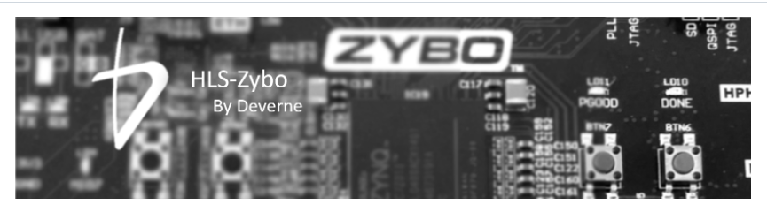
SoC
Partage d’expérience : Interaction Software / Gateware cas typique
Dans le cas d’un SoC comprenant un CPU, on retrouve souvent des architecture hybrides comprenant du Gateware et du software.
Le FPGA à un rôle dit d’ « accélérateur matériel », sont rôle est donc d’exécuter certains processus à la place du CPU.
Exemple explorer :
https://github.com/Deverne-labs/HLS-Zybo.git
Notes:
When two numbers are added on a CPU (Central Processing Unit), the CPU performs a series of steps to carry out the addition. Here's a simplified explanation of how this works:
Fetching: The CPU fetches the two numbers (in binary format) from memory or registers and loads them into its internal processing unit.
Decoding: The CPU decodes the instructions that tell it to add the two numbers together.
Addition: The CPU adds the two numbers using a series of logic gates that perform binary addition, similar to the method I explained earlier using Boolean logic. These logic gates take the two input bits and produce a sum bit and a carry bit.
Carry propagation: If there is a carry bit produced in step 3, the CPU must propagate the carry bit to the next bit position. This is done by connecting the carry output of one adder to the carry input of the next adder in a chain.
Result storage: Once the addition is complete, the CPU stores the result (in binary format) back into memory or registers.
The above process is a high-level overview of how addition is carried out on a CPU. In reality, modern CPUs are much more complex and perform many more operations in parallel. They use highly optimized circuits and algorithms to carry out arithmetic operations quickly and efficiently.

Slide 16
SoC
Partage d’expérience : Interaction Software / Gateware cas typique
Dans le cas d’un SoC comprenant un CPU, on retrouve souvent des architecture hybrides comprenant du Gateware et du software.
Le FPGA à un rôle dit d’ « accélérateur matériel », sont rôle est donc d’exécuter certains processus à la place du CPU.
Exemple explorer :
https://github.com/Deverne-labs/HLS-Zybo.git
Notes:
When two numbers are added on a CPU (Central Processing Unit), the CPU performs a series of steps to carry out the addition. Here's a simplified explanation of how this works:
Fetching: The CPU fetches the two numbers (in binary format) from memory or registers and loads them into its internal processing unit.
Decoding: The CPU decodes the instructions that tell it to add the two numbers together.
Addition: The CPU adds the two numbers using a series of logic gates that perform binary addition, similar to the method I explained earlier using Boolean logic. These logic gates take the two input bits and produce a sum bit and a carry bit.
Carry propagation: If there is a carry bit produced in step 3, the CPU must propagate the carry bit to the next bit position. This is done by connecting the carry output of one adder to the carry input of the next adder in a chain.
Result storage: Once the addition is complete, the CPU stores the result (in binary format) back into memory or registers.
The above process is a high-level overview of how addition is carried out on a CPU. In reality, modern CPUs are much more complex and perform many more operations in parallel. They use highly optimized circuits and algorithms to carry out arithmetic operations quickly and efficiently.

Slide 17
SoC
Quels métiers sont impliqués ?
Placement I/O standard, Etude consommation, DFT hardware
Memory mapping structure, DFT Gateware
Hardware
Gateware
Software
Notes:
When two numbers are added on a CPU (Central Processing Unit), the CPU performs a series of steps to carry out the addition. Here's a simplified explanation of how this works:
Fetching: The CPU fetches the two numbers (in binary format) from memory or registers and loads them into its internal processing unit.
Decoding: The CPU decodes the instructions that tell it to add the two numbers together.
Addition: The CPU adds the two numbers using a series of logic gates that perform binary addition, similar to the method I explained earlier using Boolean logic. These logic gates take the two input bits and produce a sum bit and a carry bit.
Carry propagation: If there is a carry bit produced in step 3, the CPU must propagate the carry bit to the next bit position. This is done by connecting the carry output of one adder to the carry input of the next adder in a chain.
Result storage: Once the addition is complete, the CPU stores the result (in binary format) back into memory or registers.
The above process is a high-level overview of how addition is carried out on a CPU. In reality, modern CPUs are much more complex and perform many more operations in parallel. They use highly optimized circuits and algorithms to carry out arithmetic operations quickly and efficiently.

Slide 18


SoC
Les sujets de projet, au choix
- Réalisation d’une pyramide de résolution
- Détection de points d’intérêts (corner détection)
Notes:
When two numbers are added on a CPU (Central Processing Unit), the CPU performs a series of steps to carry out the addition. Here's a simplified explanation of how this works:
Fetching: The CPU fetches the two numbers (in binary format) from memory or registers and loads them into its internal processing unit.
Decoding: The CPU decodes the instructions that tell it to add the two numbers together.
Addition: The CPU adds the two numbers using a series of logic gates that perform binary addition, similar to the method I explained earlier using Boolean logic. These logic gates take the two input bits and produce a sum bit and a carry bit.
Carry propagation: If there is a carry bit produced in step 3, the CPU must propagate the carry bit to the next bit position. This is done by connecting the carry output of one adder to the carry input of the next adder in a chain.
Result storage: Once the addition is complete, the CPU stores the result (in binary format) back into memory or registers.
The above process is a high-level overview of how addition is carried out on a CPU. In reality, modern CPUs are much more complex and perform many more operations in parallel. They use highly optimized circuits and algorithms to carry out arithmetic operations quickly and efficiently.

Slide 19
SoC
Les sujets de projet, au choix
Télécharger le logiciel d’analyse ImageJ https://imagej.net/software/fiji/downloads
Ouvrir le logiciel et « glisser-déposer » l’image fournie en exemple
Notes:
When two numbers are added on a CPU (Central Processing Unit), the CPU performs a series of steps to carry out the addition. Here's a simplified explanation of how this works:
Fetching: The CPU fetches the two numbers (in binary format) from memory or registers and loads them into its internal processing unit.
Decoding: The CPU decodes the instructions that tell it to add the two numbers together.
Addition: The CPU adds the two numbers using a series of logic gates that perform binary addition, similar to the method I explained earlier using Boolean logic. These logic gates take the two input bits and produce a sum bit and a carry bit.
Carry propagation: If there is a carry bit produced in step 3, the CPU must propagate the carry bit to the next bit position. This is done by connecting the carry output of one adder to the carry input of the next adder in a chain.
Result storage: Once the addition is complete, the CPU stores the result (in binary format) back into memory or registers.
The above process is a high-level overview of how addition is carried out on a CPU. In reality, modern CPUs are much more complex and perform many more operations in parallel. They use highly optimized circuits and algorithms to carry out arithmetic operations quickly and efficiently.

Slide 20



SoC
Détection de points d’intérêt
Notes:
When two numbers are added on a CPU (Central Processing Unit), the CPU performs a series of steps to carry out the addition. Here's a simplified explanation of how this works:
Fetching: The CPU fetches the two numbers (in binary format) from memory or registers and loads them into its internal processing unit.
Decoding: The CPU decodes the instructions that tell it to add the two numbers together.
Addition: The CPU adds the two numbers using a series of logic gates that perform binary addition, similar to the method I explained earlier using Boolean logic. These logic gates take the two input bits and produce a sum bit and a carry bit.
Carry propagation: If there is a carry bit produced in step 3, the CPU must propagate the carry bit to the next bit position. This is done by connecting the carry output of one adder to the carry input of the next adder in a chain.
Result storage: Once the addition is complete, the CPU stores the result (in binary format) back into memory or registers.
The above process is a high-level overview of how addition is carried out on a CPU. In reality, modern CPUs are much more complex and perform many more operations in parallel. They use highly optimized circuits and algorithms to carry out arithmetic operations quickly and efficiently.

Slide 21
SoC
Détection de points d’intérêt
Seuil
TPG
Filtre de Sobel (V)
+
>=
Filtre de Sobel (H)
0
Output
Cyan
1
Notes:
When two numbers are added on a CPU (Central Processing Unit), the CPU performs a series of steps to carry out the addition. Here's a simplified explanation of how this works:
Fetching: The CPU fetches the two numbers (in binary format) from memory or registers and loads them into its internal processing unit.
Decoding: The CPU decodes the instructions that tell it to add the two numbers together.
Addition: The CPU adds the two numbers using a series of logic gates that perform binary addition, similar to the method I explained earlier using Boolean logic. These logic gates take the two input bits and produce a sum bit and a carry bit.
Carry propagation: If there is a carry bit produced in step 3, the CPU must propagate the carry bit to the next bit position. This is done by connecting the carry output of one adder to the carry input of the next adder in a chain.
Result storage: Once the addition is complete, the CPU stores the result (in binary format) back into memory or registers.
The above process is a high-level overview of how addition is carried out on a CPU. In reality, modern CPUs are much more complex and perform many more operations in parallel. They use highly optimized circuits and algorithms to carry out arithmetic operations quickly and efficiently.

Slide 22



SoC
Pyramide de résolutions
Notes:
When two numbers are added on a CPU (Central Processing Unit), the CPU performs a series of steps to carry out the addition. Here's a simplified explanation of how this works:
Fetching: The CPU fetches the two numbers (in binary format) from memory or registers and loads them into its internal processing unit.
Decoding: The CPU decodes the instructions that tell it to add the two numbers together.
Addition: The CPU adds the two numbers using a series of logic gates that perform binary addition, similar to the method I explained earlier using Boolean logic. These logic gates take the two input bits and produce a sum bit and a carry bit.
Carry propagation: If there is a carry bit produced in step 3, the CPU must propagate the carry bit to the next bit position. This is done by connecting the carry output of one adder to the carry input of the next adder in a chain.
Result storage: Once the addition is complete, the CPU stores the result (in binary format) back into memory or registers.
The above process is a high-level overview of how addition is carried out on a CPU. In reality, modern CPUs are much more complex and perform many more operations in parallel. They use highly optimized circuits and algorithms to carry out arithmetic operations quickly and efficiently.

Slide 23
SoC
Pyramide de résolutions
TPG
Filtre de Gauss
Binning V & H
640x480
Filtre de Gauss
Binning V & H
320x240
Filtre de Gauss
Binning V & H
160x120
Notes:
When two numbers are added on a CPU (Central Processing Unit), the CPU performs a series of steps to carry out the addition. Here's a simplified explanation of how this works:
Fetching: The CPU fetches the two numbers (in binary format) from memory or registers and loads them into its internal processing unit.
Decoding: The CPU decodes the instructions that tell it to add the two numbers together.
Addition: The CPU adds the two numbers using a series of logic gates that perform binary addition, similar to the method I explained earlier using Boolean logic. These logic gates take the two input bits and produce a sum bit and a carry bit.
Carry propagation: If there is a carry bit produced in step 3, the CPU must propagate the carry bit to the next bit position. This is done by connecting the carry output of one adder to the carry input of the next adder in a chain.
Result storage: Once the addition is complete, the CPU stores the result (in binary format) back into memory or registers.
The above process is a high-level overview of how addition is carried out on a CPU. In reality, modern CPUs are much more complex and perform many more operations in parallel. They use highly optimized circuits and algorithms to carry out arithmetic operations quickly and efficiently.

Slide 24
SoC
Structure de la soutenance finale
20 min de présentation + 10 min de questions / réponses
Suggestion de plan :
Présentation du sujet choisi
Présentation du PV
Présentation du filtre de gauss en mode démonstration
Présentation des résultats de votre implémentation du sujet choisi
Retour sur expérience par rapport à ce projet
Notes:
When two numbers are added on a CPU (Central Processing Unit), the CPU performs a series of steps to carry out the addition. Here's a simplified explanation of how this works:
Fetching: The CPU fetches the two numbers (in binary format) from memory or registers and loads them into its internal processing unit.
Decoding: The CPU decodes the instructions that tell it to add the two numbers together.
Addition: The CPU adds the two numbers using a series of logic gates that perform binary addition, similar to the method I explained earlier using Boolean logic. These logic gates take the two input bits and produce a sum bit and a carry bit.
Carry propagation: If there is a carry bit produced in step 3, the CPU must propagate the carry bit to the next bit position. This is done by connecting the carry output of one adder to the carry input of the next adder in a chain.
Result storage: Once the addition is complete, the CPU stores the result (in binary format) back into memory or registers.
The above process is a high-level overview of how addition is carried out on a CPU. In reality, modern CPUs are much more complex and perform many more operations in parallel. They use highly optimized circuits and algorithms to carry out arithmetic operations quickly and efficiently.

